Slide 1
Picture Language Part 3
Notes:
Welcome to Picture language 3.

Slide 2

Smaller,
Simpler,
Steps
Cool and complex stuff
Notes:
In this quest, we will practice our skills of breaking up the cool and complex into smaller and simpler steps to create complex and beautiful runes.
In this way, you have more ways to create better runes for submission.

Slide 3


In the lecture earlier...
Repeating the same steps
Smaller,
Simpler,
Steps
You
Loops
Cool and complex stuff
Notes:
Here’s a quick recap of what you’ve learnt in the lecture today.
In the morning, you learn that if the smaller steps we have to create complex stuff is more or less the same, we can use loops to make our instructions simpler

Slide 4
In Picture language 2.
99 rows of nova_bb - Before
99 rows of nova_bb - After
nova_1 = nova_bb
nova_2 = stack_frac(1/2, nova_bb, nova_1)
nova_3 = stack_frac(1/3, nova_bb, nova_2)
nova_4 = stack_frac(1/4, nova_bb, nova_3)
nova_5 = stack_frac(1/5, nova_bb, nova_4)
nova_6 = stack_frac(1/6, nova_bb, nova_5)
nova_7 = stack_frac(1/7, nova_bb, nova_6)
nova_8 = stack_frac(1/8, nova_bb, nova_7)
nova_9 = stack_frac(1/9, nova_bb, nova_8)
.
.
.
nova_99 = stack_frac(1/99, nova_bb, nova_98)
result = nova_bb
for number in range(99-1):
result = stack_frac(1/(number+2), nova_bb, result)
show(result)
Notes:
We learnt to apply it to our runes in Picture language 2.
In picture language 2, we wanted to stack nova_bb into 99 rows. As you can see on the left, it’s very much similar steps.
So we used runes and changed our code into just 4 lines of code on the right.

Slide 5
In Picture language 2.
99 rows of nova_bb - After
result = nova_bb
for number in range(99-1):
result = stack_frac(1/(number+2), nova_bb, result)
show(result)
Notes:
We’ve also learnt in picture language 2 how to make our code more general.
So instead of having this set of code that generate a fix number of rows of nova_bb,

Slide 6
In Picture Language 2...
def stacker(n, rune):
result = rune
for n in range(n-1):
result = stack_frac(1/(n+2), rune, result)
show(result)
Notes:
I can make use of functions with parameters to change my code, so that it can be used to generate any rows using any runes.

Slide 7
Smaller,
Simpler,
Steps
Cool and complex stuff
Notes:
As mentioned earlier, in this picture language 3, we will practice how to break our complex runes into simpler steps. When you are more familiar with breaking complex runes into smaller steps, you’ll be better know how to create nicer runes for the contest.

Slide 8
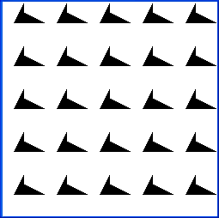
A quilting pattern
Notes:
So let’s start with our complex runes. I want to create this quilting pattern. How do I do it?
Let’s break it down. Firstly, do you see anything similar?

Slide 9

A quilting pattern
nova_bb
Notes:
Yup. The quilting pattern is essentially 25 identical nova_bb, arranged into 5 rows and 5 columns.

Slide 10
nova_bb
Notes:
So we know that at the complex quilting pattern can actually be broken down to just nova_bb. How do we do it? Again, find patterns.

Slide 11
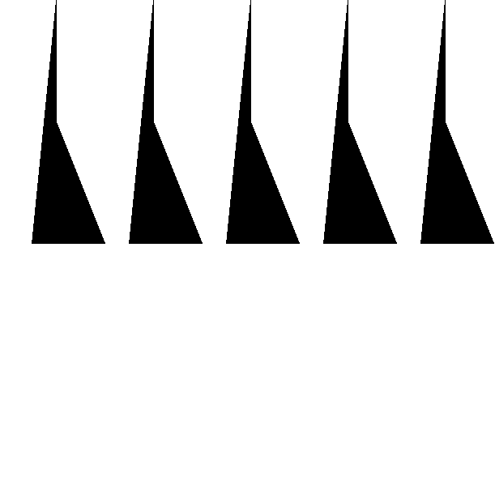
nova_bb
Notes:
Now if we were to break down the quilting pattern, it’s actually 5 identical rows, made up of the rune in yellow.

Slide 12
quarter_turn_right(pic)
turn_upside_down(pic)
beside(pic1, pic2)
stack(pic1, pic2)
stacker(n, pic)
nova_bb
Notes:
These are some of the functions we’ve learnt and/or created in our previous videos.

Slide 13
quarter_turn_right(pic)
turn_upside_down(pic)
beside(pic1, pic2)
stack(pic1, pic2)
stacker(n, pic)
n=3
nova_bb
Notes:
If you need a recap, this is what the functions do. So which function do you think allow us to stack 5 rows of the yellow rune to form our quilting pattern?

Slide 14
quarter_turn_right(pic)
turn_upside_down(pic)
beside(pic1, pic2)
stack(pic1, pic2)
stacker(n, pic)
n=3
nova_bb
Notes:
Yup. It should be staker(n,pic), which allow us to define the number of rows n, and the rune to use.
So let’s put in the code to call out the function stacker

Slide 15
quarter_turn_right(pic)
turn_upside_down(pic)
beside(pic1, pic2)
stack(pic1, pic2)
stacker(n, pic)
n=3
stacker(5, nova_bb )
Notes:
So in my code, i’ll call out the function stacker.
I put in the value for n as 5, so that the stacker will stack 5 rows.
And I need to put in the value for the 2nd parameter, the code for the yellow rune which will be stacked into the red rune.

Slide 16
stacker(5, nova_bb )
Notes:
So what's the code for the yellow rune? Let’s break it down.

Slide 17
quarter_turn_right(pic)
turn_upside_down(pic)
beside(pic1, pic2)
stack(pic1, pic2)
stacker(n, pic)
n=3
stacker(5, nova_bb )
Notes:
Is the yellow rune created by any of the function?
Well we can consider beside, but there are 5 images in the yellow rune. Beside function only allows us to place 2 runes. So it wouldn’t work.
How about stack or stacker? Well the images are not on top and bottom of each other. So it wouldn’t work either.
When we don’t know how to break it down, let’s turn it around until we see a way.

Slide 18

quarter_turn_right(pic)
turn_upside_down(pic)
beside(pic1, pic2)
stack(pic1, pic2)
stacker(n, pic)
n=3
stacker(5, quarter_turn_right(stacker(5, quarter_turn_left(nova_bb))))
Notes:
So I’ve turn it around and realise that hey! The yellow rune is actually the green rune turned right.
So in other words to generate the yellow rune, I need to call the function quarter_turn_right onto the green rune.

Slide 19
stacker(5, quarter_turn_right(stacker(5, quarter_turn_left(nova_bb))))
Notes:
So we know how to create the yellow rune. Now we need to know how to create the green rune.

Slide 20
stacker(5, quarter_turn_right(stacker(5, quarter_turn_left(nova_bb))))
Notes:
Let’s break down the green rune. Notice any patterns?

Slide 21
stacker(5, quarter_turn_right(stacker(5, quarter_turn_left(nova_bb))))
Notes:
Yup. It’s very similar to what we did earlier. It’s just 5 rows of the rune in blue.

Slide 22
quarter_turn_right(pic)
turn_upside_down(pic)
beside(pic1, pic2)
stack(pic1, pic2)
stacker(n, pic)
n=3
stacker(5, quarter_turn_right(stacker(5, quarter_turn_left(nova_bb))))
Notes:
So which function allow us to stack 5 rows of the blue runes into the green rune?

Slide 23
quarter_turn_right(pic)
turn_upside_down(pic)
beside(pic1, pic2)
stack(pic1, pic2)
stacker(n, pic)
n=3
stacker(5, quarter_turn_right(stacker(5, quarter_turn_left(nova_bb))))
Notes:
Stacker would be the one! So let’s insert the code to create the green rune

Slide 24
stacker(5, quarter_turn_right(stacker(5, quarter_turn_left(nova_bb))))
Notes:
NOw I know how to create the green rune. Lastly, I need to know how to create the blue rune.

Slide 25
stacker(5, quarter_turn_right(stacker(5, quarter_turn_left(nova_bb))))
Notes:
If we were to compare the blue rune with nova_bb, we would realise that it is just nova_bb turned left.

Slide 26
stacker(5, quarter_turn_right(stacker(5, quarter_turn_left(nova_bb))))
Notes:
So let’s call out the function (quarter)turn left, so that we can create the blue rune using nova_bb

Slide 27
stacker(5, quarter_turn_right(stacker(5, quarter_turn_left(nova_bb))))
Notes:
And there you have it. We are able to creaet our quilting pattern all the way from nova bb.
This code looks confusing, but let me walk you through.
We have break up the red quilting pattern to be made up of the yellow rune,
Which is made up of the green rune,
Which is made up of the blue rune,
Which is made up of nova_bb, the purple rune.

Slide 28
stacker(5, quarter_turn_right(stacker(5, quarter_turn_left(nova_bb))))
Notes:
So this is what IDLE will do. First, it will load up nova_bb

Slide 29
stacker(5, quarter_turn_right(stacker(5, quarter_turn_left(nova_bb))))
Notes:
And apply the function quarter turn left to it.

Slide 30
stacker(5, quarter_turn_right(stacker(5, quarter_turn_left(nova_bb))))
Notes:
And we’ve generated the blue rune.

Slide 31
stacker(5, quarter_turn_right(stacker(5, quarter_turn_left(nova_bb))))
Notes:
Next idle will call out the stacker function, so that it will stack the blue runes

Slide 32
stacker(5, quarter_turn_right(stacker(5, quarter_turn_left(nova_bb))))
Notes:
To form our green runes.

Slide 33
stacker(5, quarter_turn_right(stacker(5, quarter_turn_left(nova_bb))))
Notes:
Idle then proceed to call out the function quarter_turn_right to turn the green rune,

Slide 34
stacker(5, quarter_turn_right(stacker(5, quarter_turn_left(nova_bb))))
Notes:
So that the yellow rune will be formed.

Slide 35
stacker(5, quarter_turn_right(stacker(5, quarter_turn_left(nova_bb))))
Notes:
Lastly, idle will call out the stacker function to stack our yellow rune

Slide 36
stacker(5, quarter_turn_right(stacker(5, quarter_turn_left(nova_bb))))
Notes:
So that our red rune will finally be created.
There you have it, by working backwards to break down the complex rune, we manage to write the composite function to generate it.

Slide 37
stacker(5, quarter_turn_right( stacker(5, quarter_turn_left(nova_bb))))
Notes:
So this is our code to generate 5 rows and 5 columns of nova_bb

Slide 38
return stacker(5, quarter_turn_right( stacker(5, quarter_turn_left(nova_bb))))
Notes:
Don’t forget to insert “return”

Slide 39
def nxn(): return stacker(5, quarter_turn_right( stacker(5, quarter_turn_left(nova_bb))))
Notes:
And to make life easier, we can always define it as a function. So whenever we want to generate 5 rows and columns of nova_bb,

Slide 40
def nxn(): return stacker(5, quarter_turn_right( stacker(5, quarter_turn_left(nova_bb))))
nxn()
Notes:
We just need to call out the function.

Slide 41
def nxn(): return stacker(5, quarter_turn_right( stacker(5, quarter_turn_left(nova_bb))))
show(nxn())
Notes:
Lastly, don’t forget to include show for IDLE to show your generated rune to you.

Slide 42
Smaller,
Simpler,
Steps
Cool and complex stuff
Notes:
So now we’ve broken down our complex runes into simpler steps. And because of that, we now know how to make the beautiful quilting pattern.

Slide 43
nova_bb
Notes:
To break down complex runes, always search for patterns and break down one step at a time using the functions you already know.

Slide 44
stacker(5, quarter_turn_right(stacker(5, quarter_turn_left(nova_bb))))
Notes:
And eventually, you’ll create the code for your complex functions

Slide 45
The end

